Slide 1
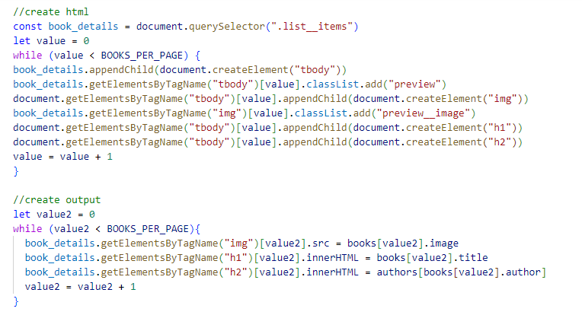
This code will create the html for the website.
The code will also display the output that the user will see when they open the website

Slide 2
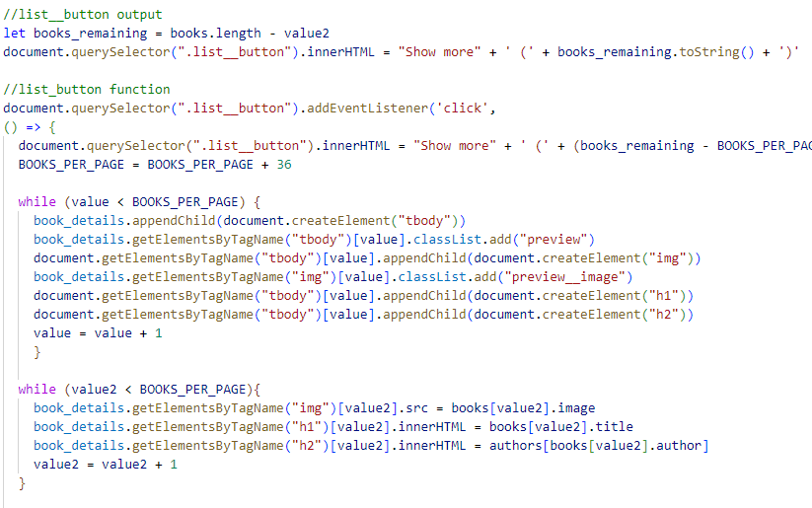
The list button output will display the ammount of books left and the list button function will create more html code to display more books on the website

Slide 3
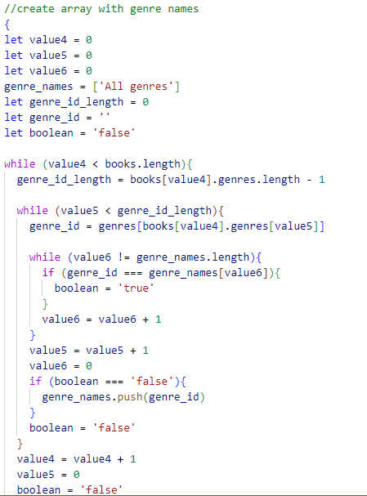
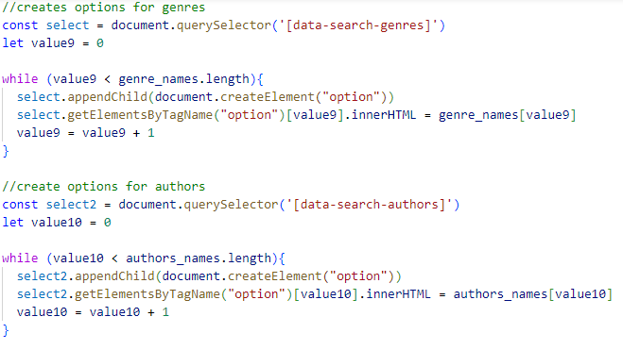
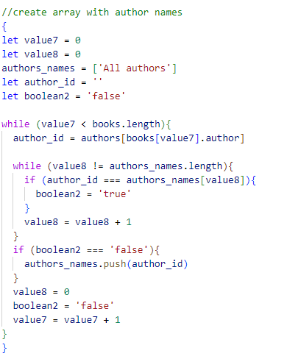
This code will generate the option to choose when you search for books

Slide 4
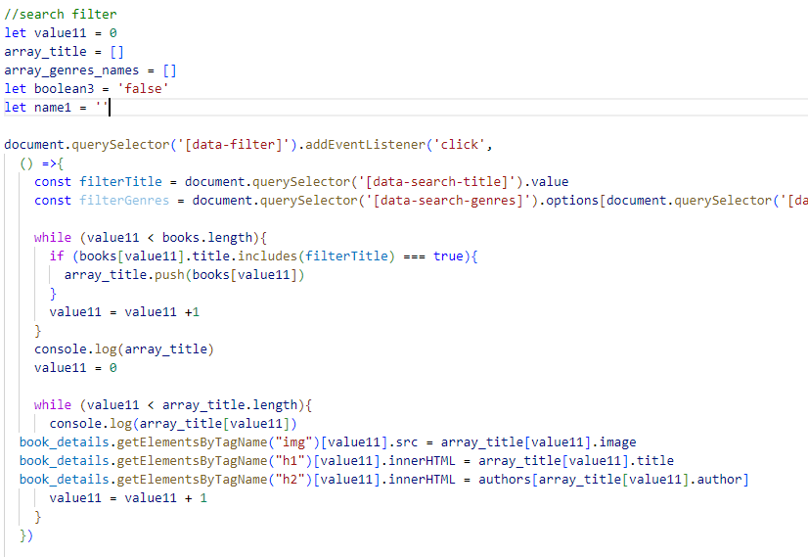
This code will search for the book that you want.

Slide 5
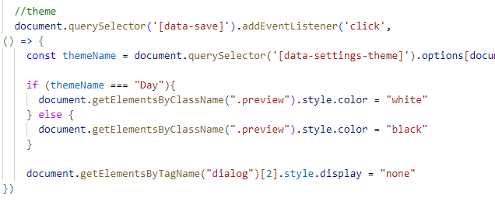
This code will change the theme.

